Slide 1
EXAMINATION LEDS
RED FOCUS LED
BUZZER
LCD BACKLIGHT
MCU
VIN=+25.5 V
REVERSE VOLTAGE PROTECTION
BNX FILTER
SWITCH MODE BUCK CONVERTER
5V
3V3 LDO
POWER SELECTOR
ESP 32
SKIN TEMPERATURE CIRCUIT
POWER DETECT PIN
WAKE UP PIN
BATTERY
LED PANEL 1
LED PANEL 2
LED PANEL 3

Slide 2



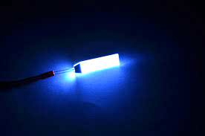
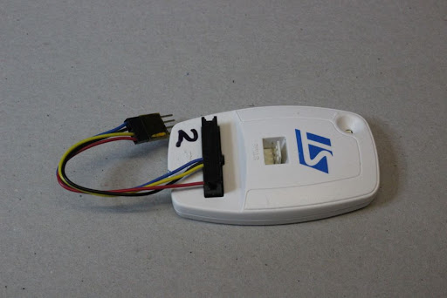
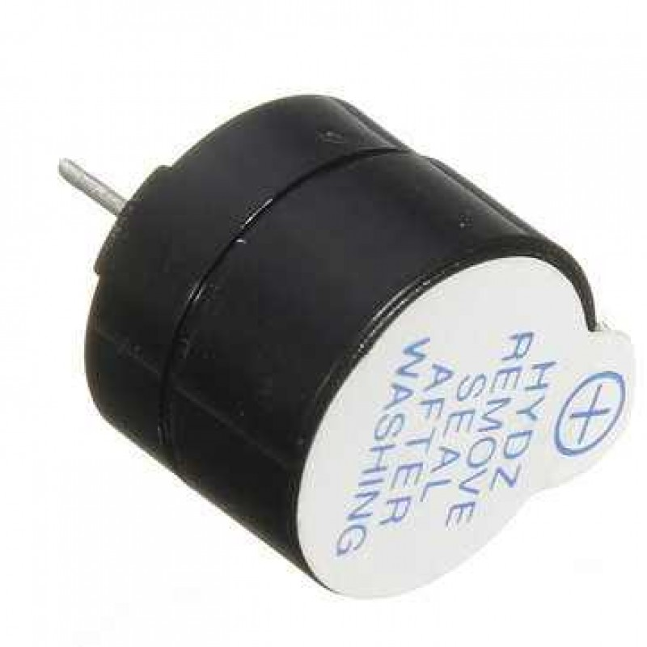
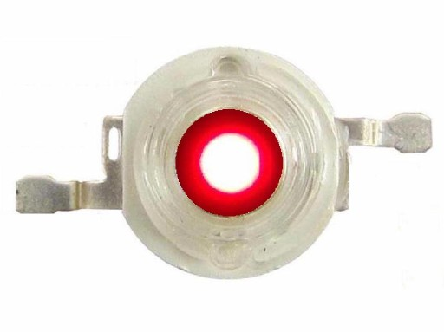
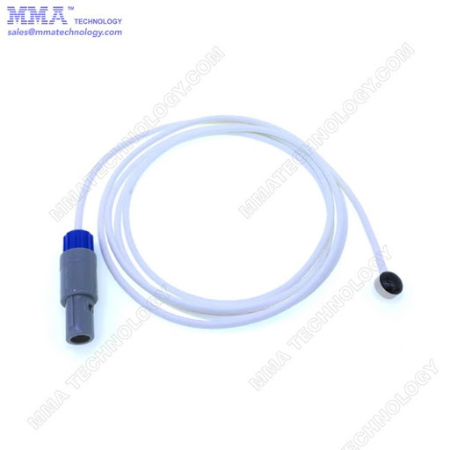
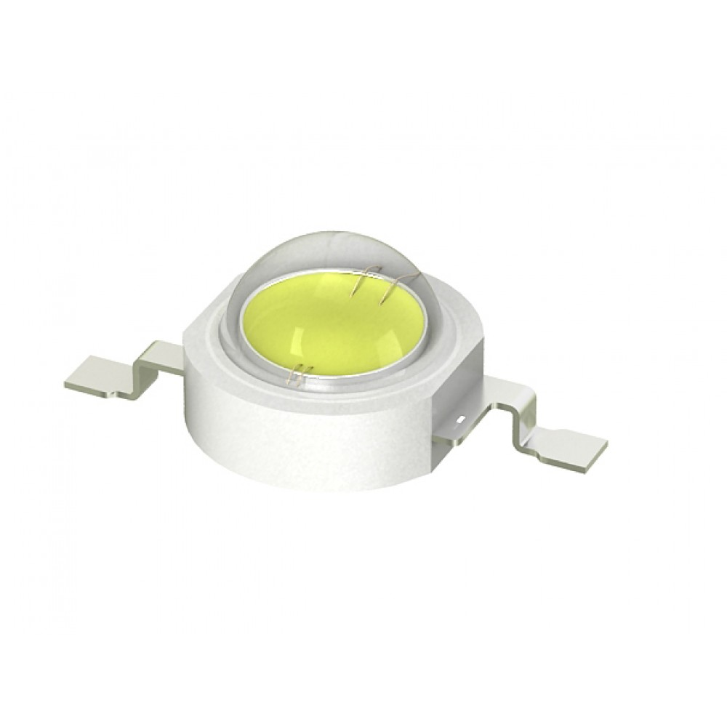
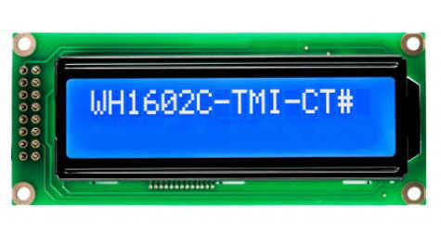
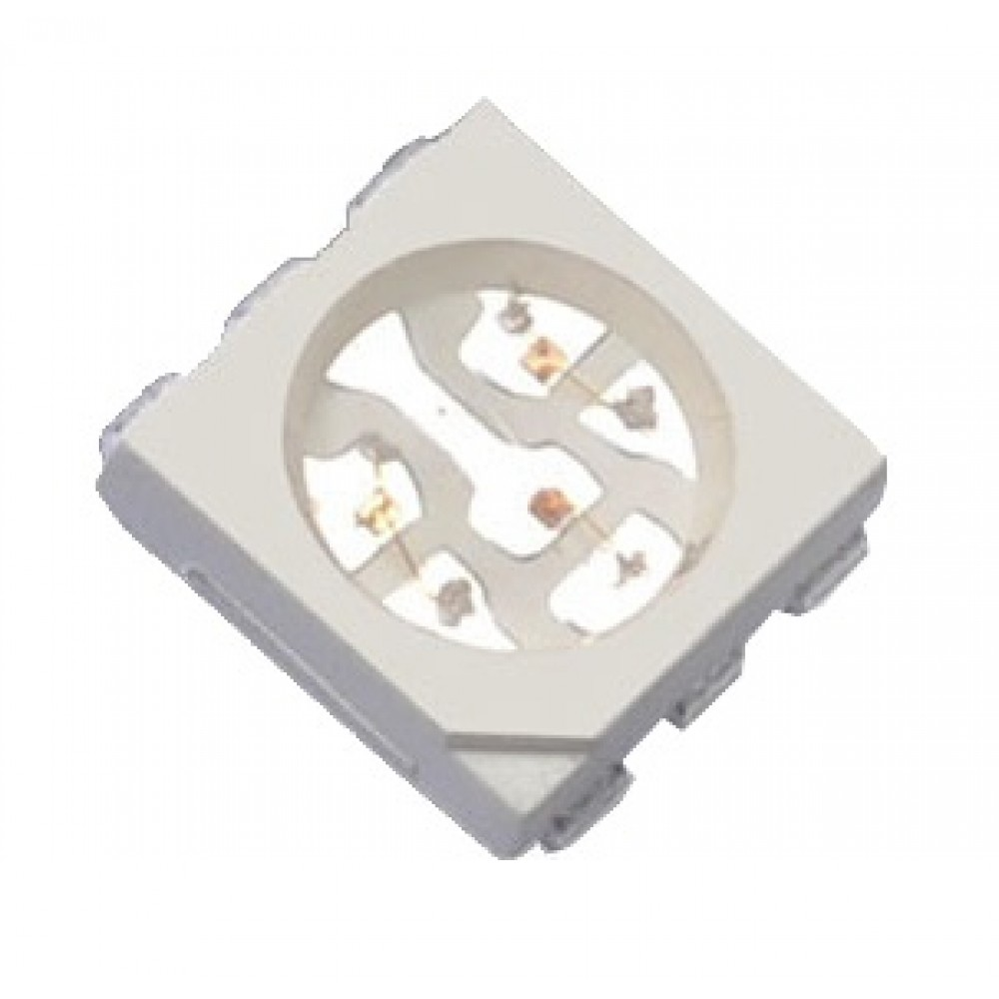
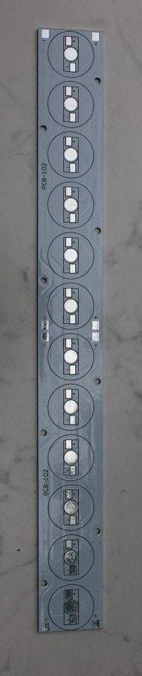
Wİ-Fİ
BLE
ESP32
LCD BACKLIGHT
MOSFET X4
UART
ESD PROTECTION X4
JTAG
JTAG
BUZZER
MCU
KEYPAD
IO
IO
IO
STM32L052 OR STM32L072
RED FOCUS LED
ADC
SKIN TEMPERATURE
ADC
RTCC EEPROM ADC DAC
EXAMINATION LEDS
IO
LCD
IO
DAC
GPIO
RGB LED
VOLTAGE CONTROLLED CURRENT SOURCE (LED DRİVER) X3
EXTERNAL DAC OR INTERNAL DAC
LED PANEL X3
DIGITAL CONTRAST SETTING

